Slide 1


2020
Movie Watch Group
Group 8
Group Member: Weizhao Li,
Peiyao Teng
Github:https://github.com/wzli1214/6234OOD

Slide 2

Backend developer’s toolkit
• Frame: Django
• Version control: Git
• IDE: Pycharm
• Package management: Pip
• Python Virtual Env: Pipenv
• Static content storage: SQlite

Slide 3

Apps
Part 01
Movie Hunter
Part 02
Polls
Part 03
Post
Part 04
User

Slide 4
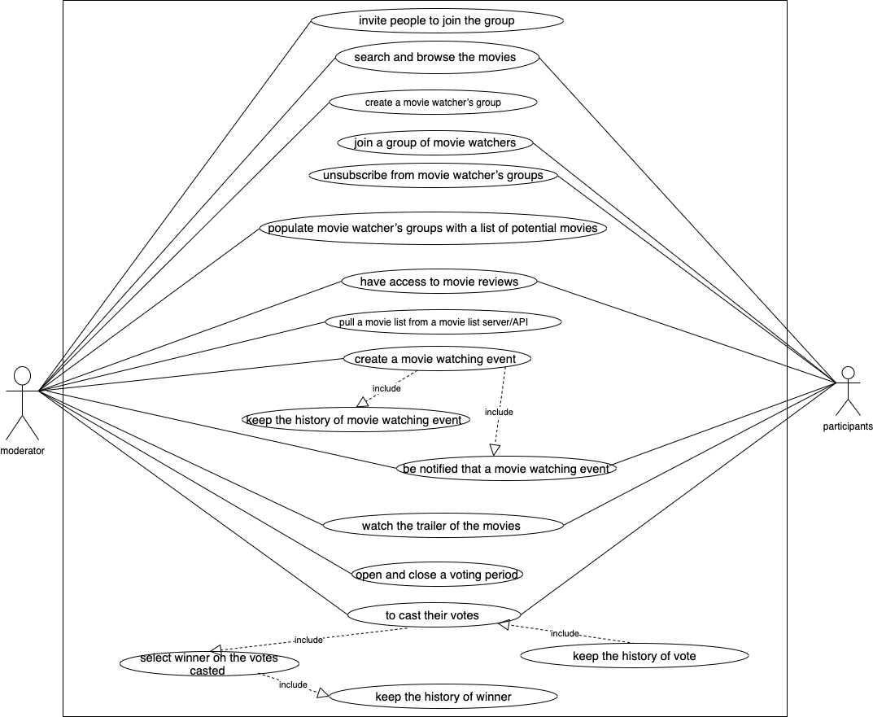

User
Case
Diagram
URL:
https://drive.google.com/open?id=1b0WE8g9S5ICMVLXRNOWXmLnYODnn_xFD

Slide 5
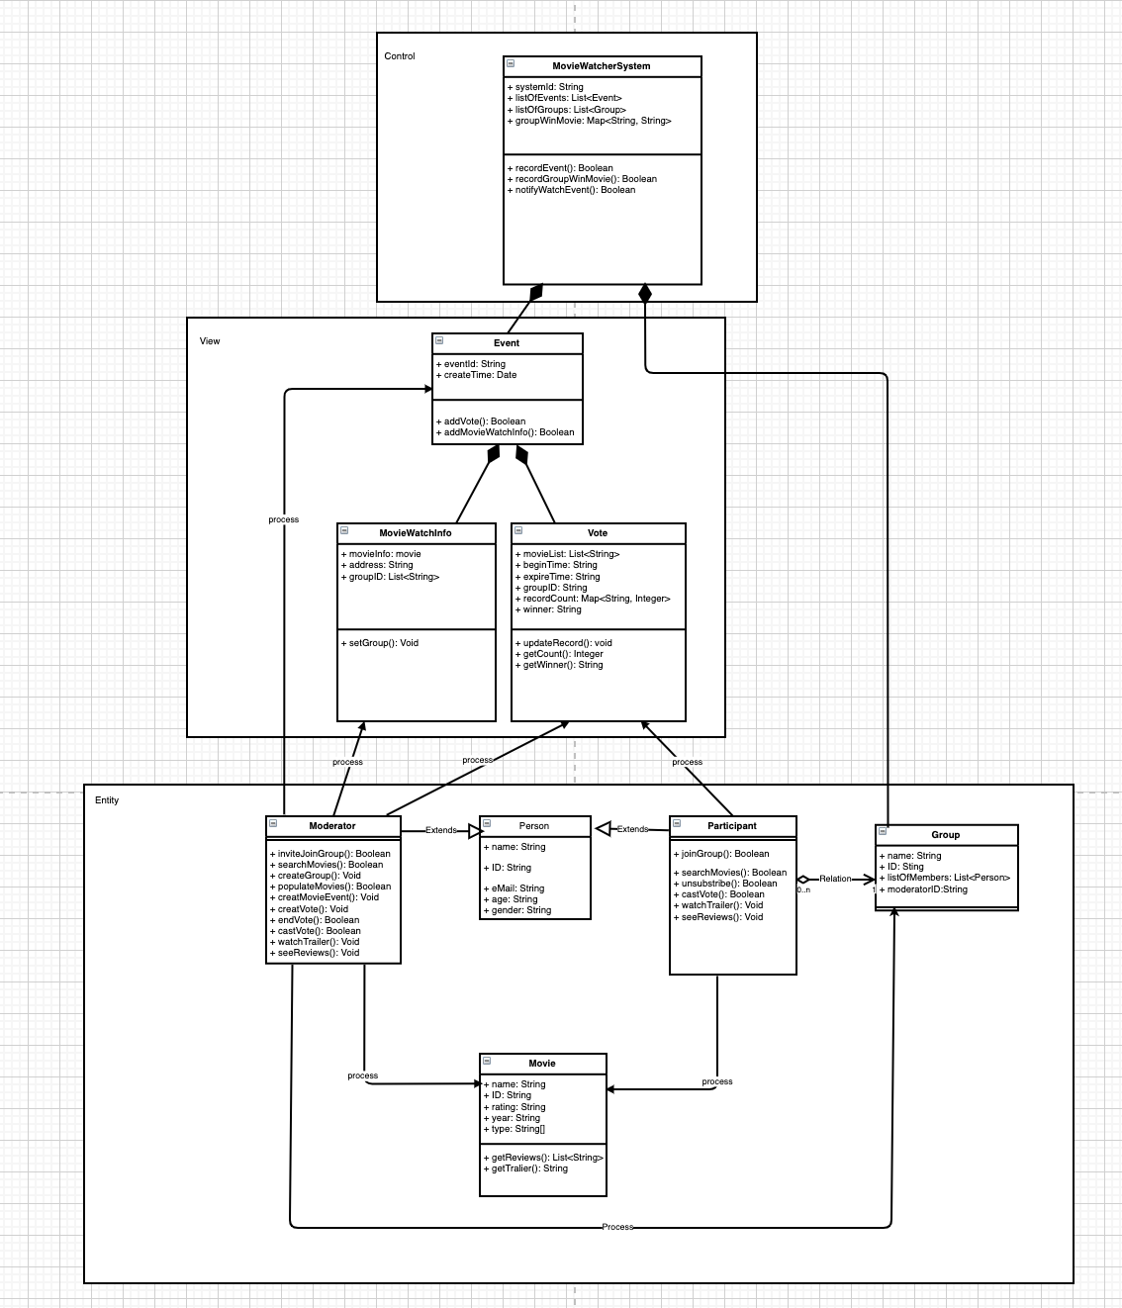
Class
Diagram
URL:
https://drive.google.com/file/d/1_RGyMUHCvq4PdBAskFoAWWv4A7xOYMCD/view?usp=sharing

Slide 6
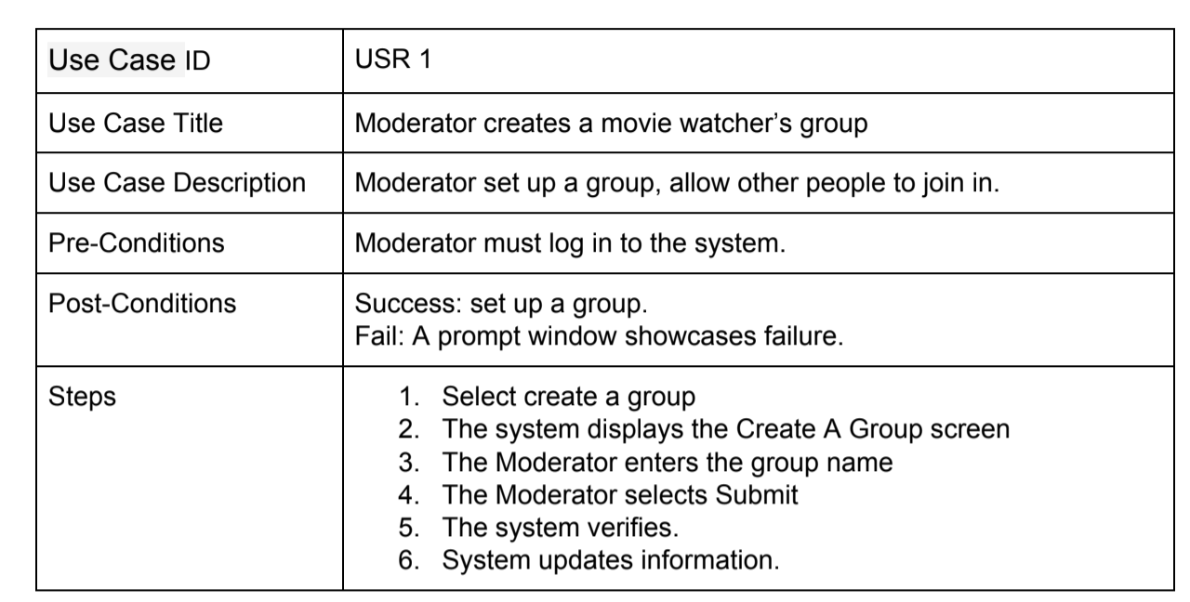
User
Case
Specifiction
URL: https://drive.google.com/file/d/1N1C8OaQiBY00mPpUkeL0Y9Y3pv2T8-fU/view?usp=sharing

Slide 7
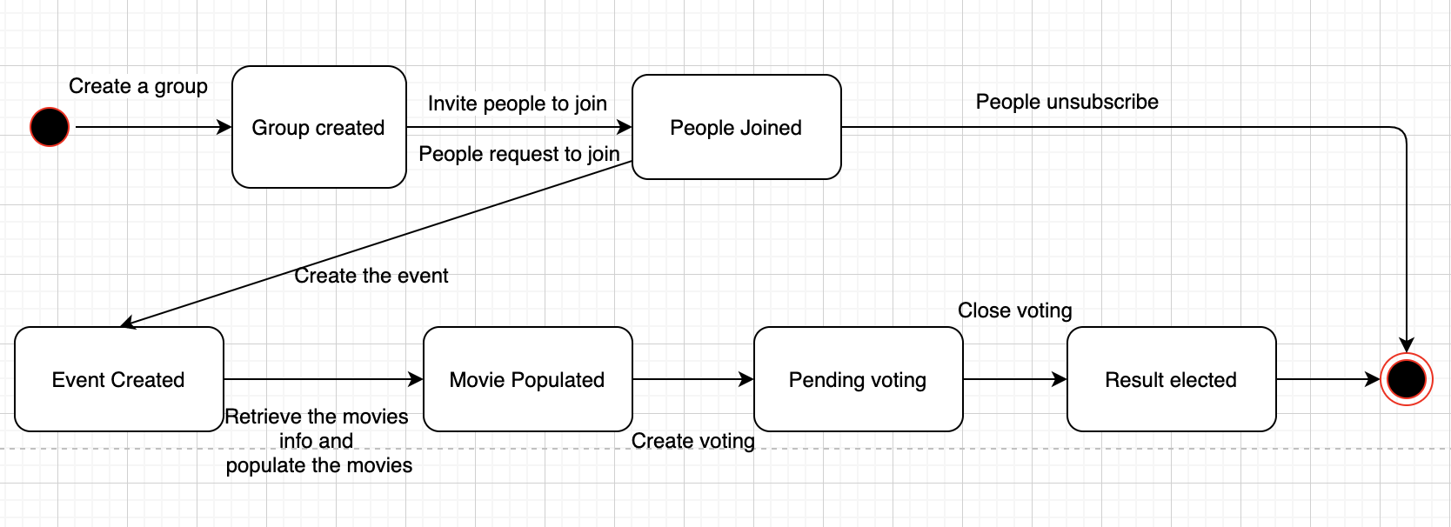
State
Diagram

Slide 8
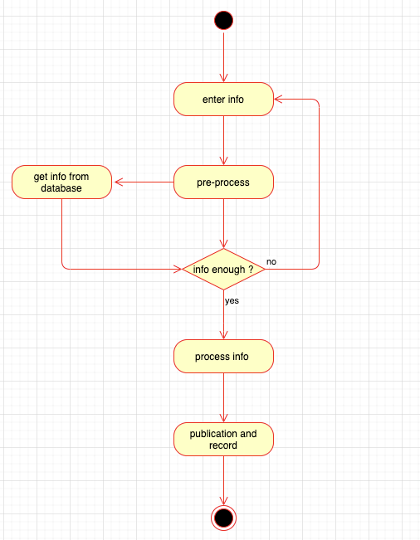
State
Diagram

Slide 9
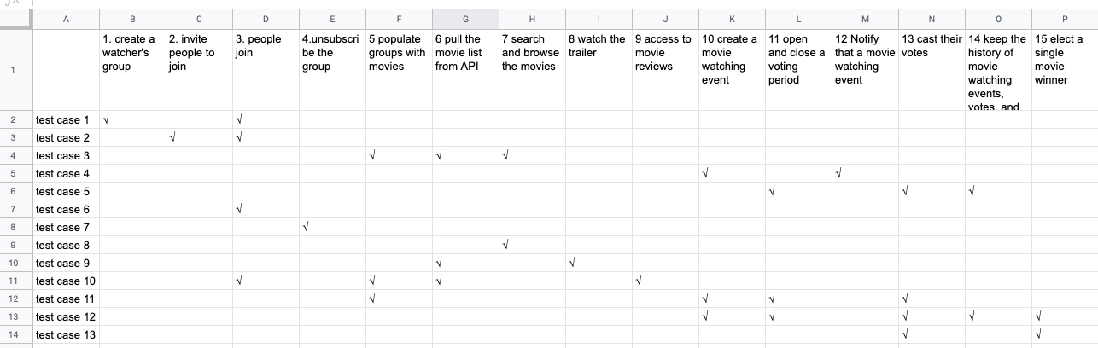
Bi-direction traceability matrix

Slide 10
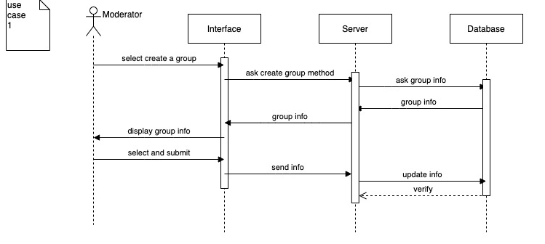
Sequence diagram
URL:
https://drive.google.com/open?id=1n753-DjR_PE4-Riyu_T10z-AIZfixYln

Slide 11
THANK YOU

